Slide 1

Predicting Customer Churn
Noah Armsworthy
November 8th, 2024

Slide 2

Problem Statement
To maintain the capital required to provide security to their customers, insurance companies must retain as many customers as possible. Predicting potential customer churn can help inform companies of critical points where retention strategies can be deployed.

Slide 3




METHODOLOGY
INITIAL ANALYSIS GETTING TO KNOW THE DATA | DATA PREPARATION Improve data quality Remove potentially misleading patterns | MODEL SELECTION Metric comparison on default parameters Cross validation | MODEL TRAINING & TUNING Hyper parameter tuning Interpret results
INITIAL ANALYSIS GETTING TO KNOW THE DATA | DATA PREPARATION Improve data quality Remove potentially misleading patterns | MODEL SELECTION Metric comparison on default parameters Cross validation | MODEL TRAINING & TUNING Hyper parameter tuning Interpret results

Slide 4
Initial Analysis
Feature Name | Distinct | Missing | Min | Max | Mean | Std
Customer ID | 1193 (20%) | 0 | 1001 | 2200 | N/A | N/A
Age | 81 (1%) | 593 (10%) | 13 | 125 | 50 | 18
Annual Premium | 1241 (21%) | 591 (10%) | 0 | 9693 | 1175 | 630
Tenure | 29 (21%) | 600 (10%) | 1 | 29 | 15 | 8.4
Province | 5 (<1%) | 0 | N/A | N/A | N/A | N/A
Marital Status | 3 (<1%) | 0 | N/A | N/A | N/A | N/A
Policy Type | 3 (<1%) | 0 | N/A | N/A | N/A | N/A
Claim Frequency | 1193 (20%) | 0 | 0 | 4.9 | 2.5 | 1.4
Customer Satisfaction | 10 (<1%) | 0 | 1 | 10 | 5.6 | 2.8

Slide 5
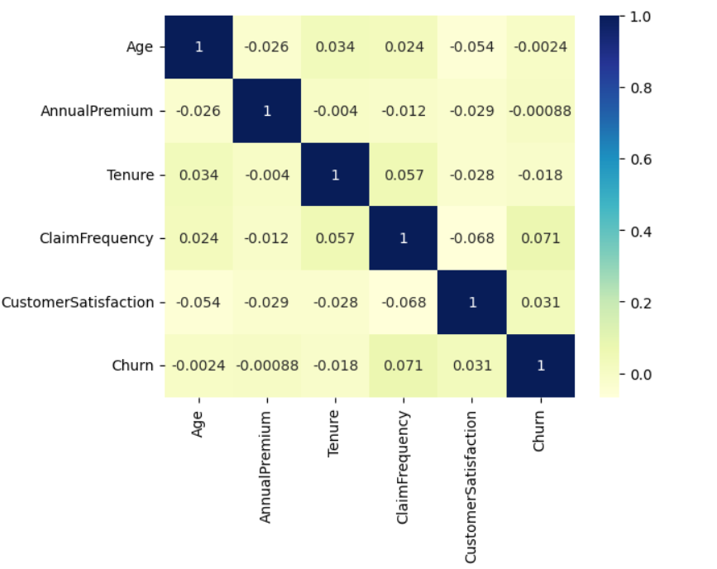
Initial Analysis
Correlation
0.0 to +0.2 | Very weak + or no association
0.0 to -0.2 | Very weak - or no association
https://sphweb.bumc.bu.edu/otlt/MPH-Modules/PH717-QuantCore/PH717-Module9-Correlation-Regression/PH717-Module9-Correlation-Regression4.html

Slide 6
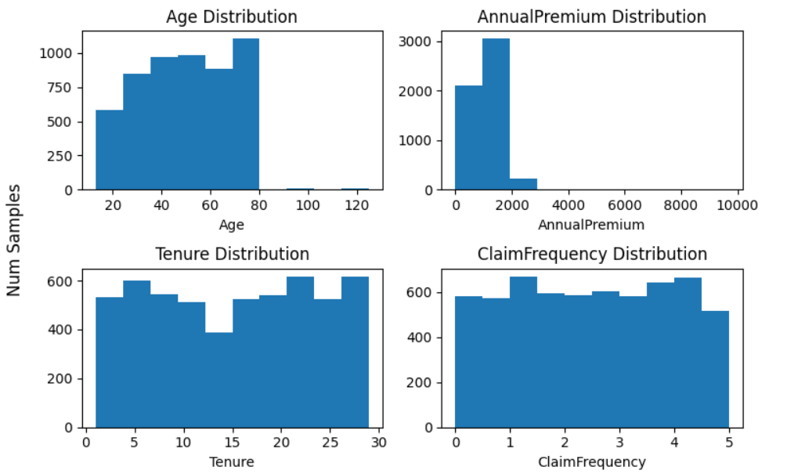
Initial Analysis
Distributions

Slide 7
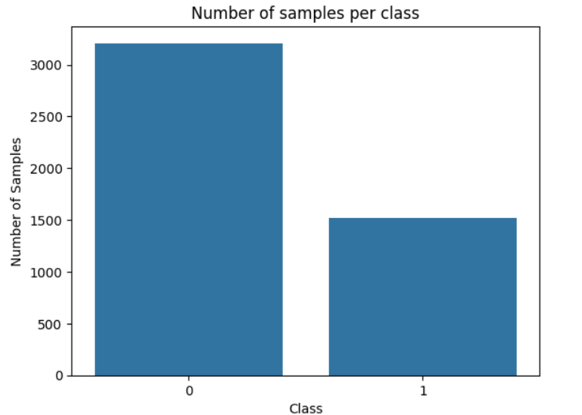
Initial Analysis
~2:1 Imbalance for No Churn

Slide 8
Data Preparation
Missing Data
Less than 0.01 correlation to the target column
5% Rule of Thumb
Use simple imputer to place the most common value in that column

Slide 9
Data Preparation
Duplicate Records
Near duplicates provide conflicting information for the same sample
If valid, entries need a date or ‘active’ column
Ultimately, dropping these would lose too much data.
Exact duplicates were dropped.
Near duplicates were kept.

Slide 10
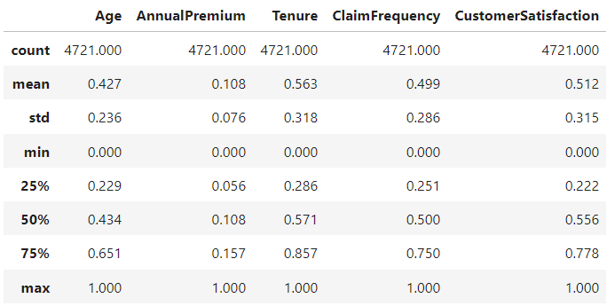
Data Preparation
Min-Max Scaling

Slide 11
Model | Accuracy | Precision | Precision | Recall | Recall | F1-Score | F1-Score | ROC AUC
Model | Accuracy | No Churn | Churn | No Churn | Churn | No Churn | Churn | ROC AUC
Logistic Regression | 67% | 67% | 0% | 100% | 0% | 80% | 0% | 55%
SVM | 67% | 67% | 0% | 100% | 0% | 80% | 0% | 55%
Decision Tree Classifier | 90% | 91% | 87% | 94% | 82% | 93% | 84% | 87%
K-Nearest Neighbor | 64% | 69% | 43% | 84% | 25% | 76% | 31% | 57%
Naive Bayes | 66% | 67% | 40% | 98% | 3% | 80% | 5% | 53%
Random Forest Classifier | 93% | 90% | 100% | 100% | 78% | 95% | 88% | 98%
Gradient Boosting Classifier | 73% | 71% | 87% | 98% | 21% | 83% | 34% | 84%
Model Selection

Slide 12
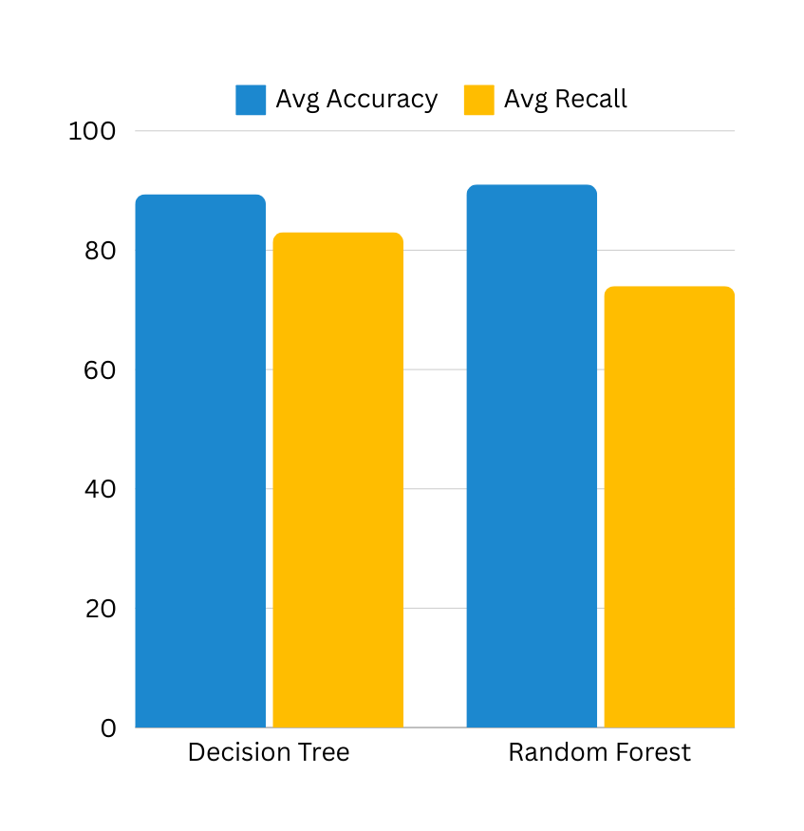
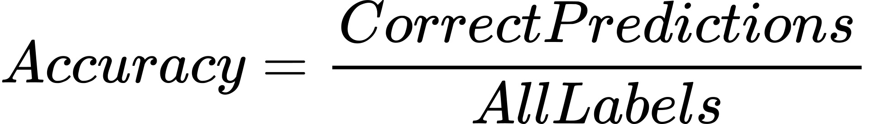
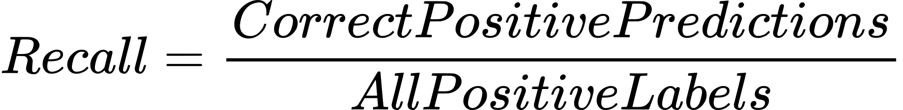
Model Selection
Decision Tree
Additional benefits of Decision Tree:
Faster training and tuning
Potentially more interpretable
Good for small datasets
Cross Validation Results

Slide 13
Decision Tree Training & Tuning
Chose f1 scoring as the harmonic mean between precision and recall.
“How good and complete are the positive predictions?”
Using Grid Search Cross Validation
Class weight: {No Churn:1, Churn: 1.5}
Criterion: ‘gini’
No specific max depth or max features.
Minimum samples per leaf: 1
Minimum required samples to split: 2
Average f1 score of 89%

Slide 14
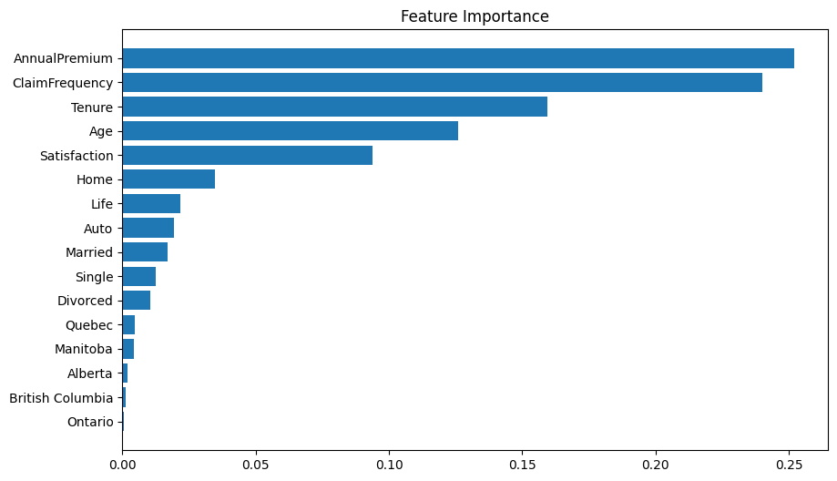
Decision Tree Metrics
92% Accuracy
88% recall
88% f1 score

Slide 15
01
Consult with the data provider about duplicates records and possible outliers.
02
Consider over/under-sampling if future data has different class distributions.
Challenges & Next Steps
03
Gather more relevant data.
04
Post-pruning for the Decision Tree may improve performance and interpretability.
05
Perform testing on a larger variety of hyper parameters.

Slide 16
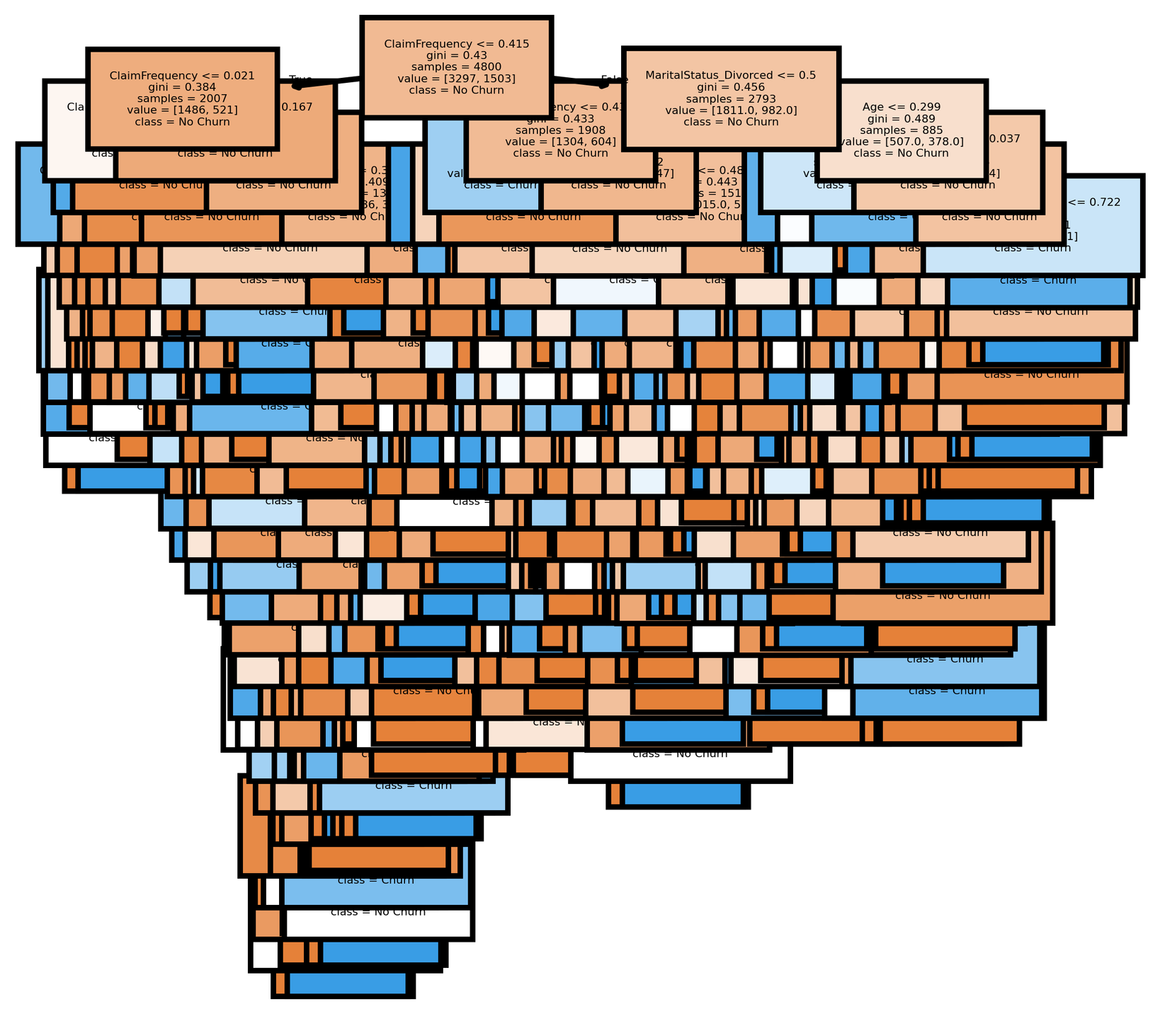
Thank you!
Noah Armsworthy
noaharmsworthy@gmail.com

